Slide 1
Workshop
Python & DroneKit | PX4 Datalogger
Diogo Silva
CAP ENGEL
10 de novembro de 2022

Slide 2
Setup - Anaconda
Install Anaconda distribution
https://www.anaconda.com/products/distribution

Slide 3
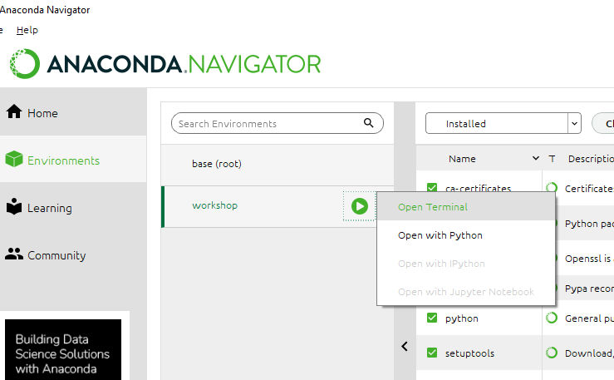
Setup - Configure
Open Anaconda Navigator
Configure Conda environment for workshop
Open Terminal

Slide 4
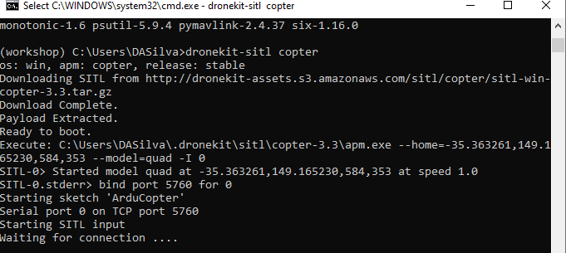
Setup - Configure
Open Anaconda Navigator
Configure Conda environment for workshop
Open Terminal
Install DroneKit
pip install dronekit
pip install dronekit-sitl –UI
pip install pyserial
Start Software in the Loop (SITL) simulation
dronekit-sitl copter

Slide 5
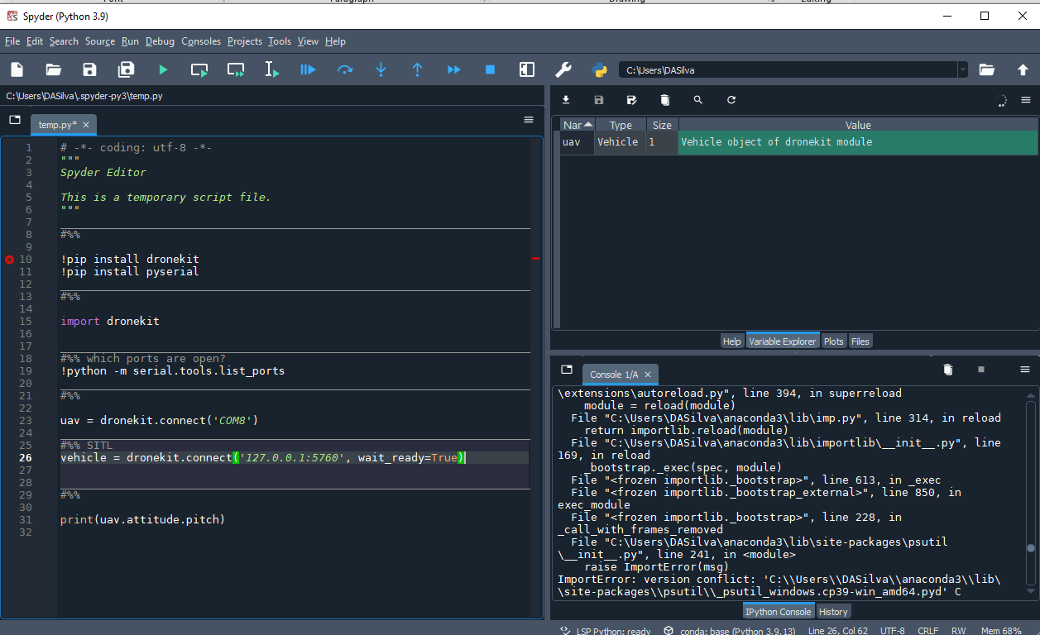
Setup - Configure
Open Anaconda Navigator
Configure Conda environment for workshop
Open Terminal
Install DroneKit
pip install dronekit
pip install dronekit-sitl –UI
Start Software in the Loop (SITL) simulation
dronekit-sitl copter
Open Spyder (code editor)

Slide 6
Code along
Variables
Types

Slide 7

if / elif / else
if statements allow us to make decisions.

Slide 8
if / elif / else
if statements allow us to make decisions.
if condition true:
do this
else:
do that

Slide 9
if / elif / else
if statements allow us to make decisions.
if condition true:
do this
elif condition2 true:
do something else
else:
do that

Slide 10
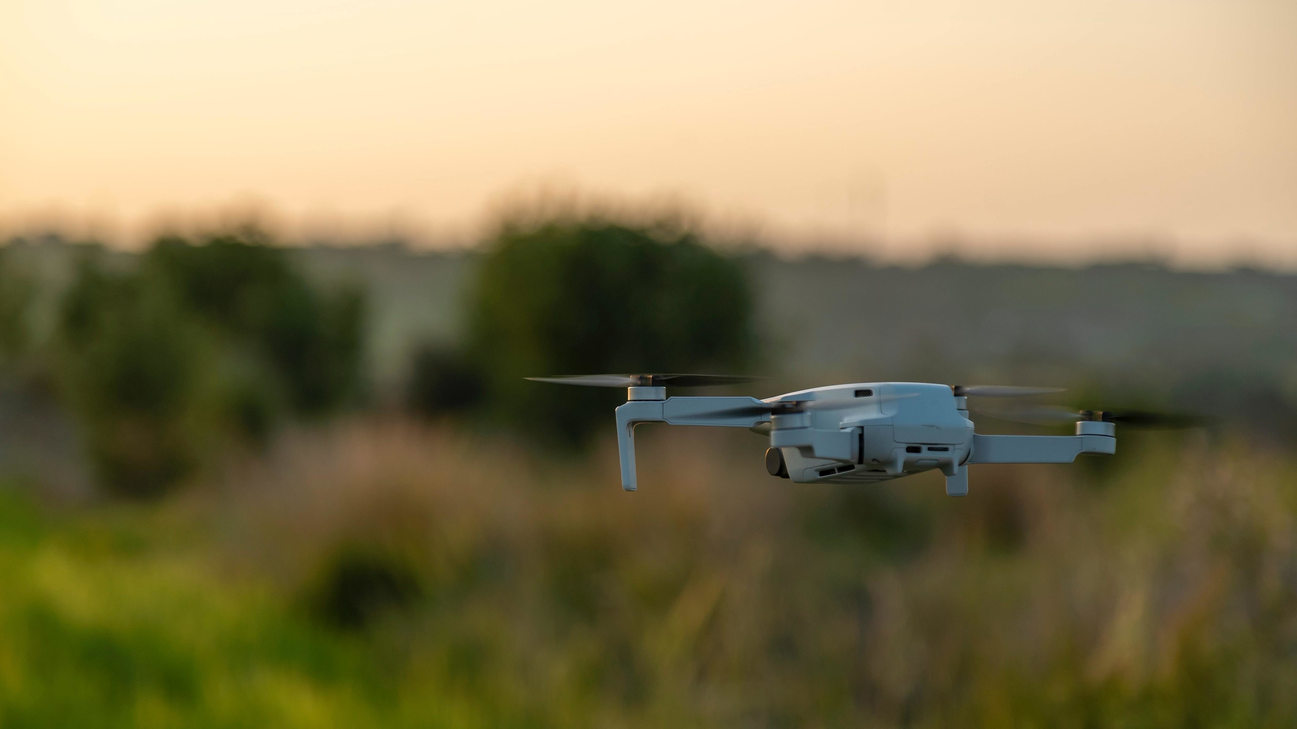
if uav.altitude < 50.0:
uav.thrust += 5

Slide 11
if uav.altitude < 50.0:
uav.thrust = 10
else:
uav.thrust = 5

Slide 12
if uav.altitude < 50.0:
uav.thrust = 10
elif uav.altitude < 10.0:
uav.thrust = 30
else:
uav.thrust = 5

Slide 13

loop
loops repeat a set of instructions as long as a certain condition is true

Slide 14
loop
loops repeat a set of instructions as long as a certain condition is true
while condition true:
instruction 1
instruction 2

Slide 15
loop
while condition true:
instruction 1
instruction 2
while uav.altitude < 50:
if uav.thrust < 10:
uav.thrust += 1
uav.thrust = 5

Slide 16
loop
while condition true:
instruction 1
instruction 2
hover_thrust = 5
while uav.altitude < 50:
if uav.thrust < 10:
uav.thrust += 1
uav.thrust = hover_thrust

Slide 17
for loop
the for loop iterates over a list of elements

Slide 18
for loop
the for loop iterates over a list of elements
for uav in uav_list:
print(uav.airspeed)

